Slide 1
Performance Evaluation

Slide 2

How do we evaluate fund managers?
We want to determine if a fund manager has “skill”
Invest with a fund if: value added > additional fees
“Skill” can be divided into two broad categories:
Stock picking (asset selection)
Finding mispriced securities
Market timing (asset allocation)
Predicting future market (or asset class) movements
We have performance measurements to help us assess each category of manager skill

Slide 3
Performance Measures
Many performance measures adjust performance for risk or opportunity cost
Adjust for total risk in the portfolio
Sharpe ratio, M² measure (RAP measure in case)
Adjust for factor exposure:
Market beta: Jensen’s alpha, Treynor Measure
Multiple factors: Fama-French 3-factor model, four/five/six/etc. factors
Compare fund to peers or a benchmark:
Peer funds or benchmark should have similar styles
e.g., compare a high-yield debt fund’s returns to the universe of high-yield debt funds
Adjust for systematic and idiosyncratic risk:
Information ratio
Investors will use different measures depending on the fund’s purpose

Slide 4
Adjust for Total Risk
Adjust for total risk in the portfolio
Sharpe ratio, M² measure (RAP measure in case)
When to use:
When the fund will be the investor’s only risky investment (i.e., makes up the entire risky portfolio
Investor will care about the return for each level of total risk (U = E[rp] - .5*A*Var )
Can combine with risk-free asset

Slide 5
Sharpe Ratio
r_{p} = portfolio average return
r_{f} = average risk-free rate
= portfolio standard deviation

Slide 6
M² Measure
Creates an adjusted portfolio (P*) that has the same standard deviation as the market index
Assumes P* is invested in portfolio P and the risk-free asset
Then compares the return on the adjusted portfolio to the return on the market
M² produces the same ranking of portfolios as the Sharpe ratio, but some people think it has more economic meaning
Notes:
Same relative measure as comparing Sharpe ratios, but with more economic meaning

Slide 7







M² Measure: Example
Managed portfolio: return=35%, =42%
Market portfolio: return=28%, =30%
T-bill return=6%
P* Portfolio:
30% = w*42% => w = .714 in portfolio P
0.286 in t-bills
r_{P*} = (.714)*35% + (.286)*6% =26.7%
r_{P*} < r_{M}, managed underperformed
M² = 26.7% - 28% = -1.3%

Slide 8
M² Breakdown

Slide 9
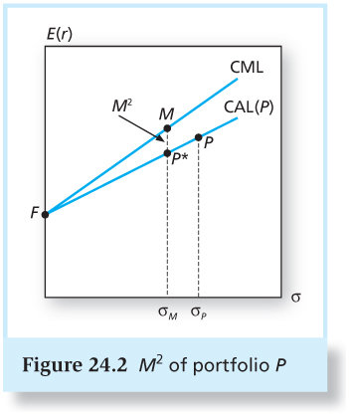
M² of Portfolio P

Slide 10
Adjust for Factor Exposure
Adjust for market beta:
Jensen’s alpha, Treynor Measure
Adjust for multiple-factors:
Fama-French 3-factor model, four/five/six/etc. factors
When to use:
If the portfolio/fund is one of many sub-portfolios within a larger investment portfolio:
The larger portfolio will be fairly well-diversified
Investor should care about return adjusted for systematic risk exposure

Slide 11
Treynor Measure
r_{p} = portfolio average return
r_{f} = average risk-free rate
= portfolio weighted average beta

Slide 12
Jensen’s Alpha
= portfolio alpha
r_{M} = market index average return
r_{p} = portfolio average return
r_{f} = average risk-free rate
= portfolio weighted average beta

Slide 13
Treynor vs. Jensen’s
T_{M} is the Treynor measure of the market, which is the same thing as the market excess return
Basically measures the alpha per unit of systematic risk
Better measure of reward-to-risk than alpha

Slide 14
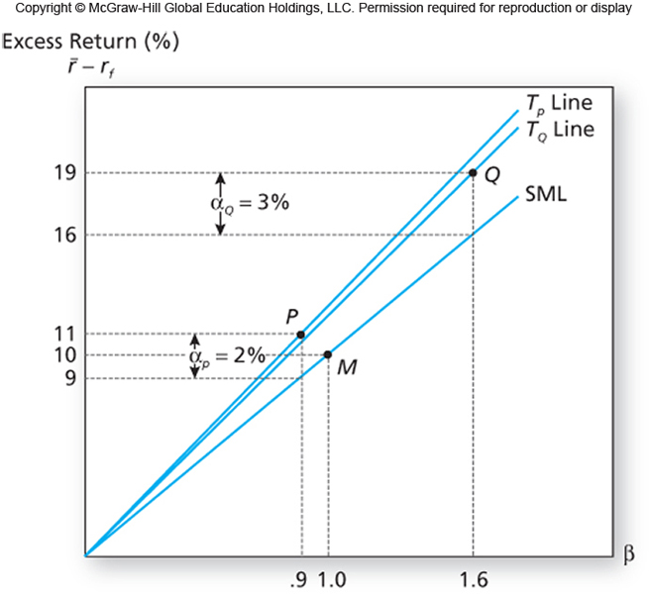
Treynor vs. Jensen’s
Slope is the Treynor measure
Distance between SML and portfolio is Jensen’s alpha

Slide 15
Factor Models and Performance
Regress portfolio returns on the factors, examine alpha
4 factor:
Examine alpha or information ratio

Slide 16
What factor model do investors use?
Jensen’s (CAPM) alpha is a better predictor of future fund flows than multi-factor model alphas
For retail mutual funds (Berk and van Binsbergen (2016), Barber, Huang and Odean (2016))
For hedge funds (Agarwal, Green and Ren (2018))
Investors are either unaware of the additional risk exposure or chase these factor returns
Fund managers can increase exotic or traditional risk factor exposure (besides the market factor) and receive higher flows

Slide 17
Peer and Benchmark Comparisons
Compare fund to other funds (or a benchmark index) with similar characteristics (styles)
e.g., compare a high-yield debt fund’s returns to the universe of high-yield debt funds
The funds should have similar styles
When to use:
When the fund will be one of many funds in the overall portfolio
Drawback: assumes factor risk exposure is similar across funds in the same asset class

Slide 18
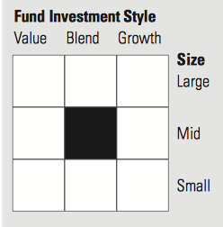
Compare within a style
Across funds, over 90% of the variation in returns is driven by the asset class(es) the fund is invested in
By comparing a fund to funds with the same style we can capture relative value-added
Morningstar
Style BoxTM

Slide 19
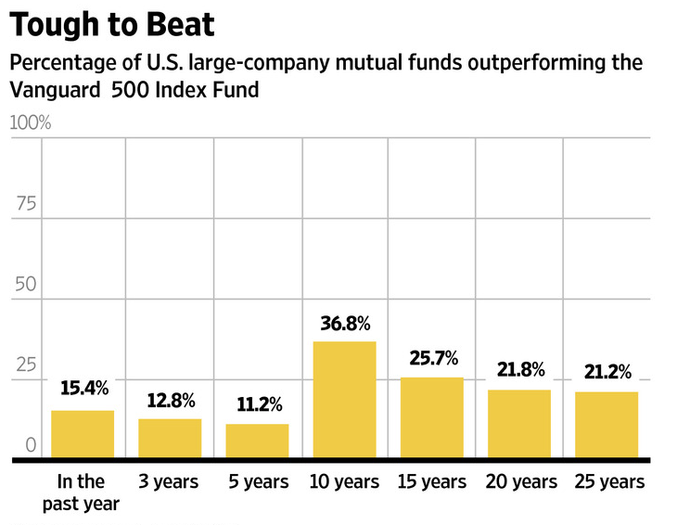
Compare to a benchmark index
We can also compare to an appropriate benchmark index
Are we better off investing in a low-cost index fund?
As of 2017

Slide 20
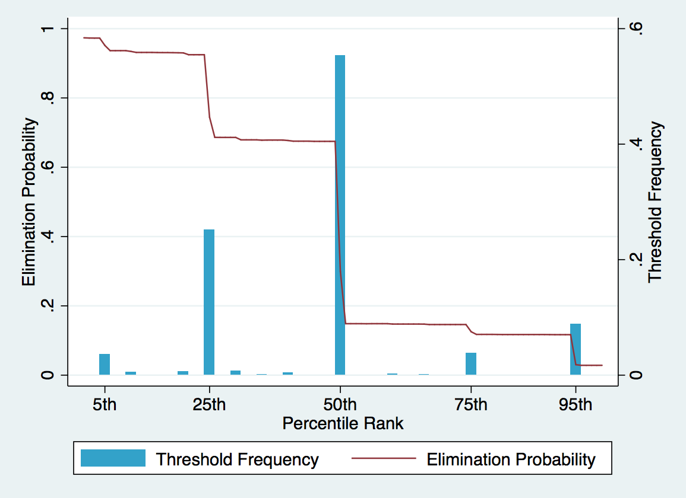
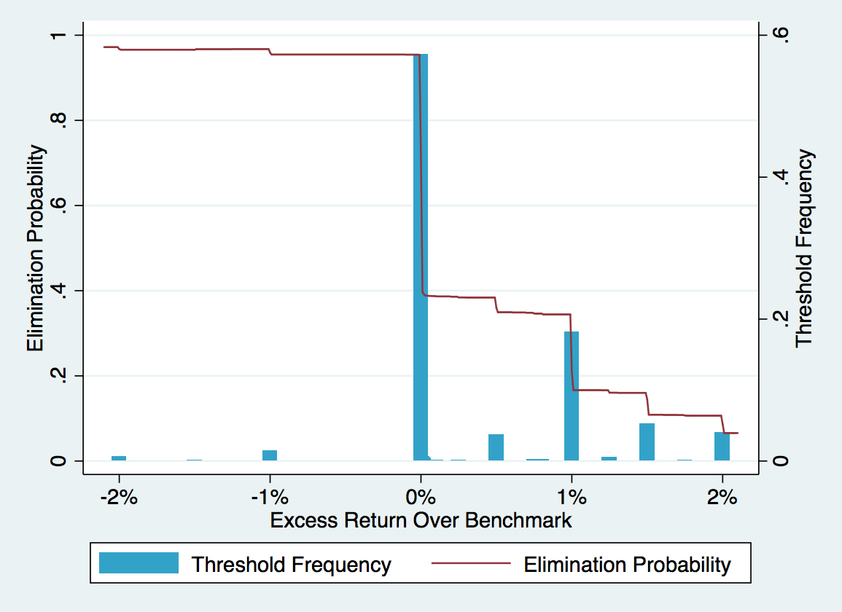
Investment Consultant Screens
Percentile rank within peer group
Excess Return Over Benchmark
Source: Chava, Kim and Weagley (2018)

Slide 21
Adjusting for Risk and Style
Adjust for systematic and idiosyncratic risk:
Information ratio
When to use:
If we are looking for an active portfolio to mix with a market index portfolio:
The Sharpe ratio of the overall investment will be maximized by choosing the active portfolio with the highest information ratio
The nonsystematic risk could, in theory, be eliminated by diversification

Slide 22
Information Ratio
Two different methods:
1. Run factor regressions:
Alpha is intercept
Std. dev. of nonsystematic risk is std. dev. of residuals
2. Compare to benchmark index
Alpha is average return difference between fund and benchmark
Std. dev. of nonsystematic risk is the std. dev. of the difference in returns between fund and benchmark
Also known as: “tracking error”

Slide 23
Performance Measurement for Hedge Funds
When an active fund (like a hedge fund) is optimally combined with a baseline market index portfolio
Sharpe ratio of overall portfolio will be determined by the hedge fund’s information ratio

Slide 24
Does past performance matter?
Past performance does not guarantee future performance:
Agarwal, Green and Ren (2018) find mixed evidence of persistence in alphas and weak evidence of persistence in performance from factor exposure (factor returns due not persist)
More generally, not much persistence in fund manager performance
Lack of persistence may be due to the best skilled managers receiving more capital
Likely decreasing returns to scale
As you increase your position, price will move against you

Slide 25
Practice Problems

Slide 26











Portfolio Performance
 | Portfolio A | Portfolio B | Market
Beta | 2 | 1.5 | 1.0
Excess return (r – r_{f}) | 12% | 9.5% | 5%
Jensen’s Alpha | ? | ? | ?
Portfolio Std. Dev. | 25% | 18% | 10%
Idio. Risk Std. Dev. | 15% | 10% | 0%
Assume the risk-free rate is 3%
Is A better than B?
Find Sharpe ratio, M-squared, Jensen’s Alpha, Treynor measure and information ratio

Slide 27
Performance Statistics
What is the Sharpe ratio?
A: 12/25 = 0.48
B: 9.5/18 = 0.53
M: 5/10 = 0.5

Slide 28
Performance Statistics
What is M²? If risk-free is 3%.
A: P* weight in A = 10/25, 15/25 in risk free
Std. Dev = (10/25)*25 = 10%
E[r*] = (10/25)*(E[r_{A}])+(15/25)*r_{f}
= (10/25)*(12+3)+(15/25)*3 = 7.8%
M² = 7.8% - 8% = -0.2%
B: P* weight in A = 10/18, 8/18 in risk free
Std. Dev = (10/18)*18 = 10%
E[r*] = (10/18)*(E[r_{B}])+(8/18)*r_{f}
= (10/18)*(9.5+3)+(8/18)*3 = 8.3%
M² = 8.3% - 8% = 0.3%
M: M² = 0

Slide 29
Performance Statistics
What is Jensen’s alpha?
A: 12% - 2*(5%) = 2%
B: 9.5% - 1.5*(5%) = 2%
M: 5% - 1*(5%) = 0%

Slide 30
Performance Statistics
What is the Treynor measure?
A: (.12)/2 = 0.06
B: .095/1.5 = 0.063
M: .05/1 = 0.05

Slide 31
Performance Statistics
What is the information ratio?
A: 2% / 15% = 0.13
B: 2% / 10% = 0.2
M: 0%/0%

Slide 32
Performance Statistics
Which do we prefer if it is our only investment (besides the risk-free asset)?
Portfolio B, highest Sharpe and M²

Slide 33
Performance Statistics
Which do we prefer if it is one of many sub-portfolios?
Still Portfolio B, highest Treynor

Slide 34
Performance Statistics
Which do we prefer if we plan to optimally combine it with the market index?
Still portfolio B, highest information ratio

Slide 35
Changing Risk Exposure and Market Timing

Slide 36
Performance Measurement with Changing Portfolio Composition
Managers may change their strategy or risk exposure over time
This can be good:
The manager may be timing the market
This may be bad:
The manager may be increasing risk because returns were poor and they need a miracle to beat their benchmark
Ex: use leverage to increase potential returns (and risk) midway through evaluation period
Evidence funds trailing the market through the first 3 quarters of the year increase fund riskiness in the 4th quarter (Chevalier and Ellison 1997)

Slide 37
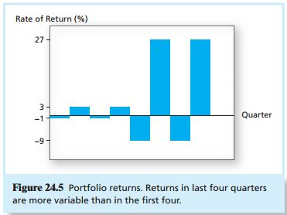
Example
Funds will change risk exposure over time
Sometimes they will increase/decrease risk depending on their past performance to maintain relative rank (decrease risk) or increase chance of improving relative rank (increase risk)

Slide 38
Market Timing
Another way the mean and variance of a portfolio’s returns will change over time is if the manager is trying to time the market
A good market timer will have a fund beta that is positively correlated with future market returns
In its pure form, market timing involves shifting funds between a market-index portfolio and a safe asset

Slide 39
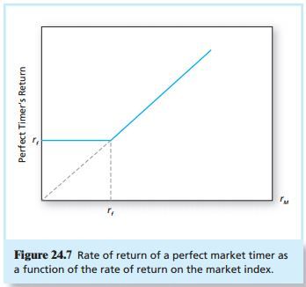
Perfect Market Timer’s Return
For a mutual fund manager (that can’t short):
Invest in the risk-free asset when the market is going to go down (beta = 0)
Invest in the market when the market is going to go up (beta = 1).
Or even higher beta assets…

Slide 40
Market Timing Measures
Estimate if manager is increasing market exposure (beta) when the market is doing well, decreasing beta when the market is doing poorly
Run regressions like the CAPM, but allow for a different beta in different market conditions
1. Treynor and Mazuy:
Estimates a quadratic relationship
Positive c usually indicates fund is good at market timing
Plot fitted line to see
2. Henriksson and Merton:
D is an indicator equal to 1 if r_{M}>r_{f}, 0 when r_{M} ≤ r_{f}
Positive c indicates fund is good at market timing
Increasing beta when the market excess return is positive

Slide 41
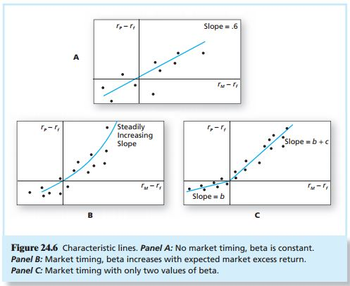
Timing
Treynor-Mazuy
fitted line
For both measures, the coefficient “c” captures market timing ability
Beta increases with expected market excess return
For H&M:
b is the fund’s beta in negative excess return periods
b+c is the fund’s beta in positive excess return periods
For Treynor and Mazuy:
Higher c means fund is earning higher returns when market returns are more extreme
Henriksson & Merton
fitted line

Slide 42
Persistence in Market Timing?
Some evidence there is persistence in market timing:
For individual investors (Keppo, Shumway and Weagley (2018))
For mutual fund managers (Kacperczyk, Van Nieuwerburgh and Veldkamp (2014)
Actually, stock pickers in good times are better market timers in bad times – they switch their attention.

Slide 43
Asset Allocation vs. Asset Selection: Comparing to a Benchmark Portfolio

Slide 44
Performance Attribution
Superior performance is achieved by:
Asset Allocation (changing weights):
Overweighting asset classes that will perform well
Underweighting asset classes that will perform poorly
Asset Selection (increasing returns):
Overweighting sectors or securities that perform well
Underweighting sectors and securities that perform poorly
To capture allocation vs. selection, we compare fund’s weights and returns in an asset class to a benchmark portfolio’s weights
Like Harvard’s policy portfolio
Use if a long-term institutional investor invested in multiple asset classes

Slide 45
Benchmark Portfolio
Choose weight in each asset class
Depends on fund’s mandate, risk profile, optimization using neutral market assumptions, etc.
Select a benchmark index portfolio for each asset class
Example:
An endowment fund may have a benchmark portfolio of 10% corporate bonds, 80% equity and 10% commodities
The indices may be Barclays Aggregate Bond Index, Wilshire 5000 and S&P Goldman Sachs Commodity Index, respectively
Notes:
Remember HMC used a benchmark portfolio

Slide 46
Example Fund
Asset Class | Fund’s Weight | Benchmark’s Weight | Fund’s Return | Benchmark’s Return
Corporate Bonds | 5% | 10% | 10% | 9%
Equity | 85% | 80% | 8% | 7%
Commodities | 10% | 10% | 6% | 6%
Notes:
Fund underweighted Corporate Bonds which did relatively well. Fund overweighted Equities which did relatively poorly. Not great at asset allocation. Pretty Good at timing.

Slide 47
Formulas for Attribution
Fund P’s overall return:
Benchmark’s overall return:
Difference in portfolio returns:
Asset Selection + Asset Allocation

Slide 48
Formulas for Attribution
Contribution from asset allocation:
Contribution from security selection:
Total contribution from asset class i:

Slide 49
Example Fund
Fund’s Overall Return = 7.9%
Benchmark’s Overall Return = 7.1%
Asset Class | Fund’s Weight | Benchmark’s Weight | Fund’s Return | Benchmark’s Return
Corporate Bonds | 5% | 10% | 10% | 9%
Equity | 85% | 80% | 8% | 7%
Commodities | 10% | 10% | 6% | 6%
Asset Allocation:
Asset Selection:
Notes:
Fund underweighted Corporate Bonds which did relatively well. Fund overweighted Equities which did relatively poorly. Not great at asset allocation. Pretty Good at timing.

Slide 50
Summary
Many performance measures
Which one to use depends on how the investment is used
Performance can be attributed to different skills
Market timing, asset class timing
Security selection

Slide 51
Manipulation

Slide 52
Performance Manipulation
Managers may try to manipulate performance measures
Employ strategies to improve performance at the loss of investors
Ex: use leverage to increase potential returns midway through evaluation period
Evidence funds trailing the market through the first 3 quarters of the year increase fund riskiness in the 4th quarter (Chevalier and Ellison 1997)
Ingersoll, et al. examine whether or not performance measures are manipulation-proof
All of the performance measures presented can be manipulated except MRAR
Notes:
Most make assumption that rates of return are independent and drawn from the same distribution.
Arbitrary changes in leverage/risk are utility reducing

Slide 53
Morningstar Risk-Adjusted Return
r_{t} (r_{ft}) is the return on the portfolio (risk-free asset) in period t
γ measures risk aversion
Morningstar sets to 2
Can be thought of as the risk-free equivalent excess return of P with a certain risk aversion (γ)
Gives more weight to poor returns
Notes:
http://www.mutualfundobserver.com/2014/03/morningstars-risk-adjusted-return-measure/

Slide 54
Details:
How Morningstar describes MRAR:
Morningstar adjusts for risk by calculating a risk penalty for each fund based on “expected utility theory,” a commonly used method of economic analysis. Although the math is complex, the basic concept is relatively straightforward. It assumes that investors are more concerned about a possible poor outcome than an unexpectedly good outcome and that those investors are willing to give up a small portion of an investment’s expected return in exchange for greater certainty. A “risk penalty” is subtracted from each fund’s total return, based on the variation in its month-to-month return during the rating period, with an emphasis on downward variation. The greater the variation, the larger the penalty. If two funds have the exact same return, the one with more variation in its return is given the larger risk penalty.

Slide 55
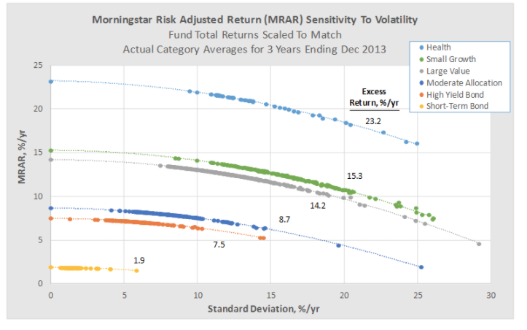
http://www.mutualfundobserver.com/2014/03/morningstars-risk-adjusted-return-measure/
Essentially: penalizes high volatility funds

